Slide 1
PostgreSQL in PaxosLand
A study IN DISTRIBUTED PERSISTENCE

Slide 2

Claimers, Disclaimers And such…
What this talk is about.
What this talk is NOT about.
Who I am.
What I do.
Is this topic of any relevance to the industry.

Slide 3
Roadmap Y’know, in case we get lost in the awesomeness
What is CAP, Consensus, Concurrency, Correctness, Consistency
What’s my beef with the above mentioned Cs
What I found out

Slide 4
ELI5: CAP, Consensus and Correctness
What makes computer engineers rocket scientists.

Slide 5
Consistency 101
Codification of process CRUD on a distributed system.
Deceptively complicated, surprisingly intuitive.
Many models/flavors, again no size fits all. Some examples:
Strict Consistency
Linearizability -> Sequential consistency
Causal consistency
Eventual consistency
Problem arises when you make copies of stuff
$ x = 1;
$ puts x; #1
$ x = 2;
$ puts x; #1?
1
2
Harder to program
Scalable
Less intuitive
1
Notes:
The problem has many names:
Microprocessor cache coherence
Thread concurrency and parallelism
Distributed persistence

Slide 6
Consistency Pfft! What’s so hard about it?
Really only need to answer two questions:
Is stale read an option and if so, how stale is stale?
Ordering of writes across replicas
$ x = 1;
$ x = 2; $ puts x; #1? or 2?
$ x = 1;
$ x = 2; $ puts x; #2
$ puts x; #1
Notes:
Hmm, lets being by asking what exactly is time? Is real time the only time?
What about the perception of time? Do I see the same time as you do?
How fast is communication? Is light fast enough?
Must everyone know everything? Must only one person know everything?
Who gets to decide? Why should he/she get to decide? Should one person get to decide?

Slide 7
Consistency: Strict This time with pictures!
R(x)a: Read x and got a
W(y)b: Wrote y to b
Global time (wall clock / real)
T | T+1 | T+2 | T+3 | T+4 | T+5 | T+6 | T+7 | T+8
W(x)1
 | W(x)2
 |  | R(x)? |  | R(x)?
 |  |  | R(x)? |  | R(x)?
T | T+1 | T+2 | T+3 | T+4 | T+5 | T+6 | T+7 | T+8
W(x)1 | W(x)2 | R(x)2 | R(x)2 | R(x)2 | R(x)2 | … | … | …
W(x)1 | W(x)2 | R(x)2 | R(x)2 | R(x)2 | R(x)2 | … | … | …
W(x)1 | W(x)2 | R(X)2 | R(x)2 | R(X)2 | R(x)2 | … | … | …
W(x)1 | W(x)2 | R(x)2 | R(X)2 | R(x)2 | R(x)2 | … | … | …
P1:
P1:
P2:
P2:
P3:
P3:
P4:
P4:
2
2
2
2
----------------------------------------------- Strict Consistency

Slide 8
Consistency: Sequential Again, with pictures!
R(x)a: Read x and got a
W(y)b: Wrote y to b
Global time (wall clock / real)
T | T+1 | T+2 | T+3 | T+4 | T+5 | T+6 | T+7 | T+8
W(x)3 |  | W(x)1
 | W(x)2
 |  |  | R(x)? |  | R(x)?
 |  |  |  | R(x)? |  | R(x)?
T | T+1 | T+2 | T+3 | T+4 | T+5 | T+6 | T+7 | T+8
W(x)3 | R(x)3 | W(x)1 | R(x)1 | R(x)1 | W(x)2 | R(x)2 | … | …
W(x)3 | R(x)3 | W(x)1 | R(x)1 | R(x)1 | W(x)2 | R(x)2 | … | …
W(x)3 | R(x)3 | W(x)1 | R(x)1 | R(x)1 | W(x)2 | R(x)2 | … | …
W(x)3 | R(x)3 | W(x)1 | R(x)1 | R(x)1 | W(x)2 | R(x)2 | … | …
P1:
P1:
P2:
P2:
P3:
P3:
P4:
P4:
3
1
1
2
----------------------------------------------- Sequential Consistency

Slide 9
Consistency: Causal Final time with pictures!
Rules:
W(x)1 || W(x)2
W(x)2 < R(x)? < W(y)1
R(x)@ < W(x)3
R(x)a: Read x and got a
W(y)b: Wrote y to b
Global time (wall clock / real)
T | T+1 | T+2 | T+3 | T+4 | T+5 | T+6 | T+7 | T+8
W(x)1 |  |  | R(x)# | R(x)&
W(x)2 | R(x)? | W(y)1
 | R(x)@ | W(x)3
 |  |  | R(y)$ | R(x)^
T | T+1 | T+2 | T+3 | T+4 | T+5 | T+6 | T+7 | T+8
W(x)1 | … | … | R(x)1 | W(x)3 | R(x)3 | … | … | …
W(x)2 | R(x)2 | W(y)1 | … | … | … | … | … | …
W(x)1 | R(x)1 | W(x)3 | … | … | … | … | … | …
W(x)2 | … | W(y)1 | R(y)1 | R(x)2 | … | … | … | …
P1:
P1:
P2:
P2:
P3:
P3:
P4:
P4:
1
2
1
1
3
2

Slide 10
The (in)famous CAP theorem Is it really a theorem?
Eric Brewer, UC Berkley, keynote presentation.
Later made a paper which proves a partial of the conjecture.
It was and remains a truism – that is, it cannot be unproved.
CAP:
C: Consistency/Uniformity of data at all locations
A: Availability of the data service (accessible in “reasonable” time)
P: Partition Tolerance of the system’s “correctness” in the face of communication loss between locations

Slide 11
Once again, CAP This time with pictures!
Set(k, 3)
k = 3
k = 3? Yeah?
k = 3? Yeah?
k = 3
k = 3? Yeah?
k = 3
get(k)

Slide 12
Things go wrong. Aka $h!7 hits the fan
Well…we could:
Get the user to wait until we reconcile the loss of communication, so CAP
Serve the user the wrong best-known value for (k), so CAP
Either collapse all 3 machines into one (CA), or guarantee per-partition consistency, so cAP
Set(k, 4)
k = 3
k = 4
k = 4? Yeah?
get(k)
k = 3? Yeah? Yeah?
…Dude?
k = 3
k = 3
k = 4

Slide 13
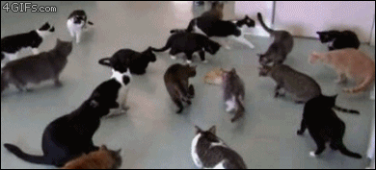
Synkat! Per partition consistency

Slide 14
So, which is best? (c)CA/CP/AP
Like all other hard questions, the answer is none.
Most of these questions usually ask “can you tell me what is most important to me?”
Depends on the nature of the system!
A media CDN system would likely go for AP
A banking system would want CP
We actually use (c)CA because we simply do not have any P!

Slide 15


Slide 16
Consensus 101
Agreement.
When consistency is not a luxury.
Arbitration of ordering and race conditions.
Usually enforced by protocols.

Slide 17

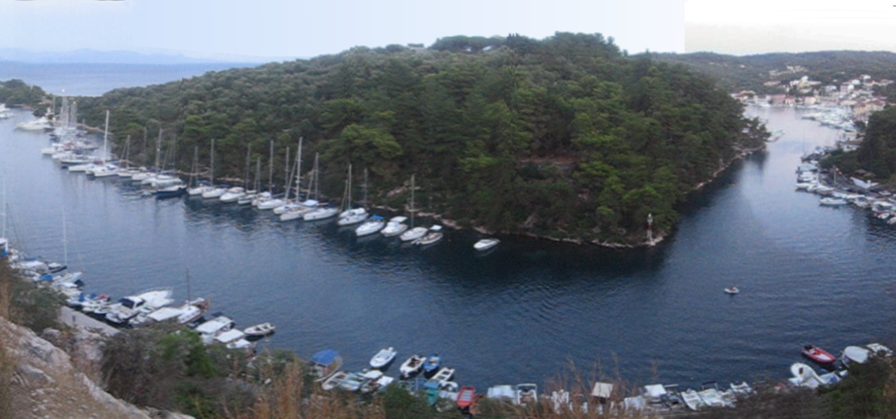





Paxos (pop: ~2300)

Slide 18
Consensus : Paxos This time with pictures!
3
blue
1: green
2: blue
2
blue
1
blue
2: blue
green
Client
Client
1: green

Slide 19
Paxos Pfft, why is this hard?
Honestly, it’s not.
But a happy path is…well, happy. Imagine if things start failing.
We discussed a single round of Paxos, what happens when there are multiple rounds?
Trivially, multiple rounds of single Paxos = MultiPaxos, but is a 2-step process really necessary?
Paxos guarantees correctness but not liveness.

Slide 20
MultiPaxos (because one island wasn’t enough)
3
Process | Round1 | Round2 | Round3 | Round4
P3 | W(x)1 | R(x) | R(y) | W(x)2
P1 | W(x)1 | R(x) | R(y) | W(x)2
P2 | W(x)1 | R(x) | R(y) | W(x)2
Round1 | Round2 | Round3 | Round4
W(x)1 | R(x) | R(y) | W(x)2
Correctness
2
1
T | T+1 | T+2 | T+3 | T+4 | T+5 | T+6 | T+7 | T+8
W(x)1 | W(x)2 | R(x)2 | R(x)2 | R(x)2 | R(x)2 | … | … | …
W(x)1 | W(x)2 | R(x)2 | R(x)2 | R(x)2 | R(x)2 | … | … | …
W(x)1 | W(x)2 | R(X)2 | R(x)2 | R(X)2 | R(x)2 | … | … | …
W(x)1 | W(x)2 | R(x)2 | R(X)2 | R(x)2 | R(x)2 | … | … | …
Consistency (Strict)
Round1 | Round2 | Round3 | Round4
W(x)1 | R(x) | R(y) | W(x)2
Round1 | Round2 | Round3 | Round4
W(x)1 | R(x) | R(y) | W(x)2

Slide 21
Correctness Like consistency, but timeless
Correctness is by definition whatever you deterministically define it to be.
Usually this works out to be serializability.
Actual wall clock times of operation do not matter for correctness.
Linearizability (Strict Consistency) | Serializability (Correctness)
1) Obtain 5 eggs | 1) Obtain 5 eggs
2) Crack ‘em open in bowl | 2) Add salt and pepper
3) Add salt and pepper | 3) Mix vigorously
4) Mix vigorously | 4) Fry in pan
5) Fry in pan | 5) Crack ‘em open in a bowl

Slide 22
And more eggs…
Sometimes, the answer is to just make the programmers more aware and put the onus on them!
Transactional
After having obtained 5 eggs { After having cracked them open in a bowl { After having added x salt and y pepper { After having mixed vigorously { Fry in pan } and you can stop mixing now } and you can put the salt and pepper back now } and you can clean the bowl and put it back now } and you can put the remaining eggs back now
Idempotent
1) If you haven’t already obtain 5 eggs, do so. If not, try to obtain 5 eggs.
2) If you have obtained 5 eggs and have not yet cracked them open in a bowl, do so. If you haven’t obtained 5 eggs yet, try to do so. If you have 5 eggs, but you haven’t cracked them open in a bowl yet, try to do so.
3) If you have obtained 5 eggs and …
Long Tx is long!

Slide 23
Why did this happen? Because time and tide wait for no one.
Time.
Hard to obtain an accurate timestamp of a request.
Is now() really now()?
Harder when you have multiple systems involved.
Who’s now() is now()?

Slide 24
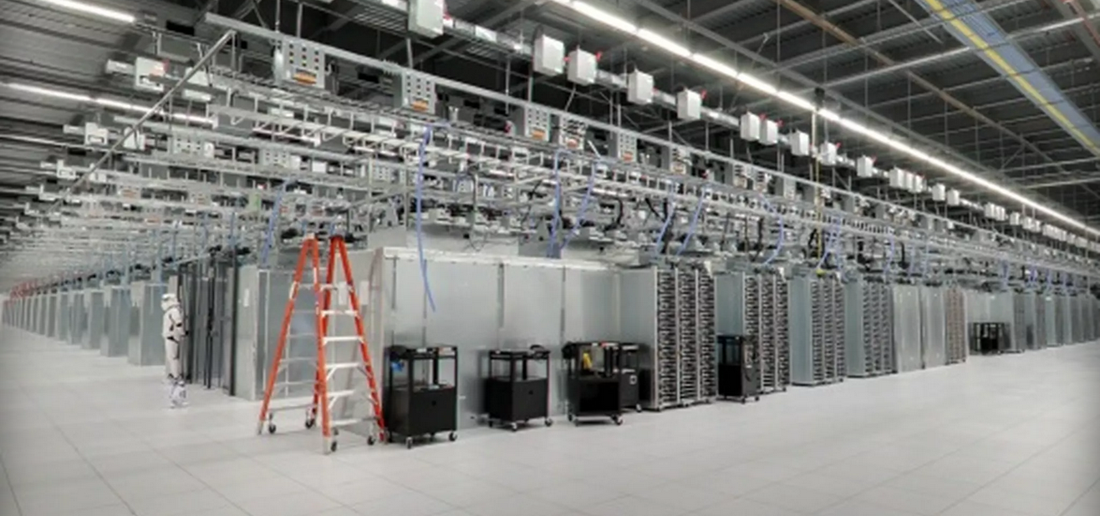
Spanner Google: Making grad students cry since 2004

Slide 25
Pop Quiz Time! How consistent was it again?
Hot-standby
Cold-standby
Daisy chained
Flail
BDR

Slide 26
Roadmap Still with me?
What is CAP, Consensus, Concurrency, Correctness, Consistency
What’s my beef with the above mentioned Cs
What I found out

Slide 27
Data: A mobile, responsive organism
It also does other organism-y stuff

Slide 28


Geo-Replicated Cloud Storage aka Global Saving
Durability
Access Latencies
Typically asynchronous
?!
Notes:
Diff from CDN – stronger consistency requirements in storage.
Examples! Cassandra, Spanner

Slide 29
Classes of Geo-Replicated Cloud Storage just when you thought it couldn’t be more boring
Consistent Hashing based systems | Directory based systems
Compute hash once to store data, recompute hash to find data | Maintain a directory to manage locations of data
No predictability, adaptability in data placement | Flexibility, predictability and adaptability in data placement
Implicitly correct by virtue of properties of hash function | Correctness is not trivial – an important implementation consideration
Example: Cassandra, Dynamo | Example: SPANStore, DTunes, Spanner SPANStore – Zhe Wu et al. DTunes – ISL (our group) Spanner – James Corbett et al.
Dir
Dir
Configuration Logic
Dir
?
Dir
?
Dir
Dir
Directory
Family of Hash
Functions
Obj1 | NY,CA
… | …
… | …
H(k)
NY,GA
H(k) + 1
Notes:
While adaptive to workload shifts, the challenge with dir based systems is to maintain all the directories “correctly”.

Slide 30
Why Paxos? …well, why not Paxos?
Object | Replica Set
U1 | NY, GA
… | …
Object | Replica Set
U1 | NY, CA
… | …
U1
Single Point of Failure!
U1
Object | Replica Set
U1 | NY, GA
… | …
Object | Replica Set
U1 | NY, CA
… | …
U1
Object Movement
Object | Replica Set
U1 | NY, CA
… | …
Directory Updates

Slide 31
JPaxos because Apple stole iPaxos
High performance Java implementation
Round robin view-based leader election
Every process plays every role (Proposer, Acceptor, Learner)
Open sourced
Jan Kończak (PUT), Nuno Santos(EPFL), Tomasz Żurkowski(PUT), Paweł T. Wojciechowski(PUT), and André Schiper(EPFL)
Notes:
EPFL, Switzerland
Poznan University of Technology, Poland

Slide 32
PostgreSQL NOT Postgré, PostgresSQL etc.
Open source relational database system
Runs on all major OS
Rich query language and high performant query optimizer
Active development for 15 years

Slide 33
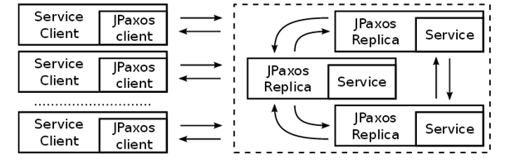
The Pawns tl;dr: every stateful operation is Paxos-ly(ful?)
Directory Client
Directory Client
Directory Client
Directory Service
Mig Init
Protocol
Protocol
Protocol
Migration Agent
Dir
Migration Agent
Dir
Migration Agent
Dir

Slide 34
Directory Service: DB State
Stateless in memory – all state is persisted
Handles API requests for migrations – creates a record for each object migration
ObjId | Old Set | New Set | Dir ACKs | Mig ACKs | Created At | Completed At | Last Updated At | Mig Started At | Migrated? | Completed?
Obj-1 | 1,2 | 1,3 | Dir1,Dir2 | Agt1 | <time> | <time> | <time> | <time> | F | F
Obj-2 | 1,4 | 2 | Dir1,Dir2 | Agt1,Agt2 | <time> | <time> | <time> | <time> | T | T
… | … | … | … | … | … | … | … | … | … | …
Every insert/update operation on these records must be Paxos!
Updated Directories
Completed Migration chunks
When last touched? Avoid starvation.
When was object movement request last (re)initiated?
Is object movement complete?
Is migration request complete?

Slide 35


Migration Protocol Protocols in protocols: Protoception
Stateless, seamless takeover on failure
Directory Service
(Paxos Replica 1)
Directory Service
(Paxos Replica 2)
Directory Service
(Paxos Replica 3)
Protocol 1
Protocol 2
Protocol 3

Slide 36
Migration Protocol: DB state
Assume 1 migration agent, 3 directories
ObjId | Old Set | New Set | Dir ACKs | Mig ACKs | Created At | Completed At | Last Updated At | Mig Started At | Migrated? | Completed?
Obj-1 | 1,2 | 1,3 | Null | Null | T1 | Null | T1 | Null | F | F
Obj-1 | 1,2 | 1,3 | Null | Null | T1 | Null | T2 | T2 | F | F
Obj-1 | 1,2 | 1,3 | Null | 1 | T1 | Null | T3 | T2 | F | F
Obj-1 | 1,2 | 1,3 | Null | 1 | T1 | Null | T4 | T2 | T | F
Obj-1 | 1,2 | 1,3 | 1 | 1 | T1 | Null | T5 | T2 | T | F
Obj-1 | 1,2 | 1,3 | 1,2 | 1 | T1 | Null | T6 | T2 | T | F
Obj-1 | 1,2 | 1,3 | 1,2,3 | 1 | T1 | Null | T7 | T2 | T | F
Obj-1 | 1,2 | 1,3 | 1,2,3 | 1 | T1 | T8 | T8 | T2 | T | T

Slide 37
Crash Recovery aka “How I learnt to stop worrying and love my DB”
For log truncation, on demand snapshots of the database must be made.
Dump DB, serve dumpfile as snapshot. Delete DB and restore completely from dumpfile.
Log file
DB
Request ID | Request
1 | INSERT x,10
2 | UPDATE x,20
3 | READ x
4 | INSERT y,4
5 | UPDATE y,y+4
… | …
x | y
10 | -
20 | -
20 | -
20 | 4
20 | 8
… | …
equivalent

Slide 38
Roadmap Hey! Look at that, we made it through…
What is CAP, Consensus, Concurrency, Correctness, Consistency
What’s my beef with the above mentioned Cs
What I found out

Slide 39
Results
TIME to make stuff up

Slide 40
Experimental Setup
Mig Init
Migration Agent 0
Replica 2
Dir2
Replica 0
Protocol 2
Dir0
Protocol 0
Replica 3
Dir3
Replica 1
Protocol 3
Dir1
Protocol 1
Replica 4
Dir4
Protocol 4
Intra-coast (ms) RTT links
Inter-coast (ms) RTT links
#4 is always leader, all clients forced to connect to #4.
No redirection.

Slide 41

Latency Breakdown how I spent my milliseconds
Queuing delay
Paxos client
Link latency
Dir Client
Paxos convergence time
Database access time
Distance from leader to
3rd closest replica (in 5 node cluster)
Composed of:
a) network component
b) queuing delay

Slide 42
Instrumented Paxos Rounds TL;DR y-Axes
Initiation – instantiate new migration
DB create new record
Dir Acks – updating that directory has ACKed new data location
DB update migration record
Update Timestamp – update migration started timestamp
DB update migration record
Mig Agent Acks – migration agent ACK
DB lookup migration agent and update migration record
Migration Complete – set boolean flag to true
DB update migration record

Slide 43
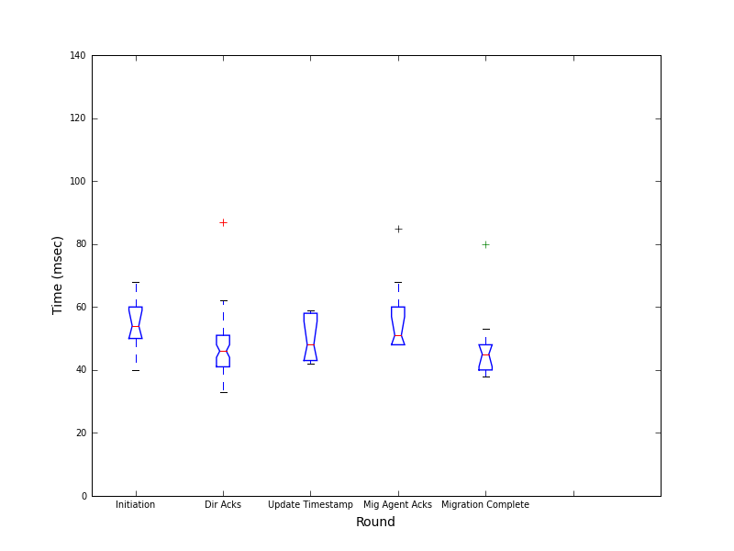
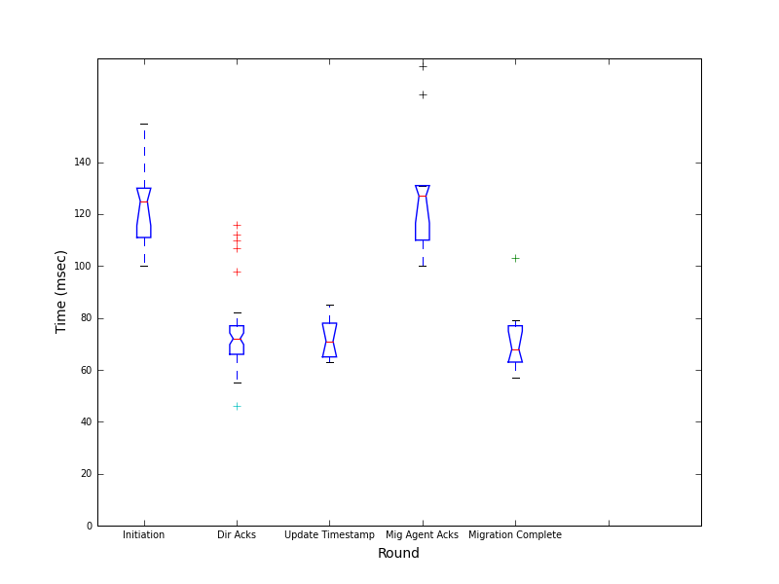
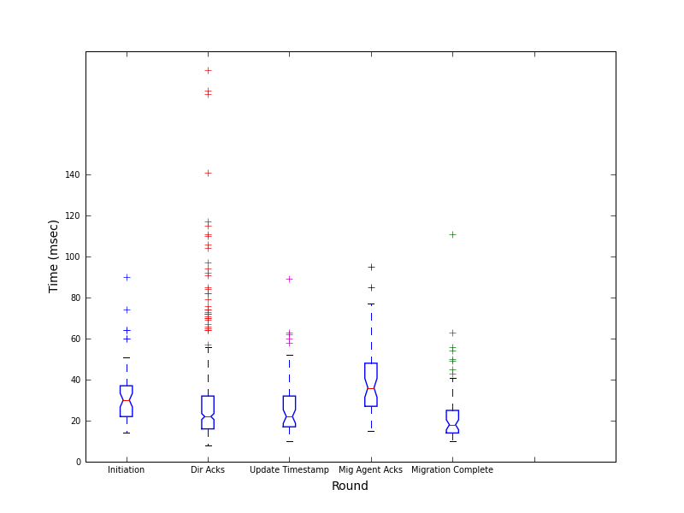
Intercoast – 80ms, Intracoast – 20ms
Client end to end
Paxos
Database + Protocol
Notes:
Note:
The split – 70 = 50ish + 20ish.
Note variation in Paxos latencies due to queuing delay
3rd closest replica is East coast distance => Paxos should converge in 20ms (but Dummynet overhead)

Slide 44
Intercoast – 80ms, Intracoast – 20ms
Client end to end
Link delay
Corresponding DB times
Notes:
Link delay – once again, 20ms dummynet overhead

Slide 45
Intercoast – 80ms, Intracoast – 20ms
Database
Initiation is an insert
Mig Agent Acks involves multiple DB accesses
Notes:
Mention that in the thesis we vary the latency parameters and present other results:
6ms, 60ms
0ms, 60ms
0ms, 0ms
20ms, 60ms
60ms, 120ms
20ms,20ms

Slide 46
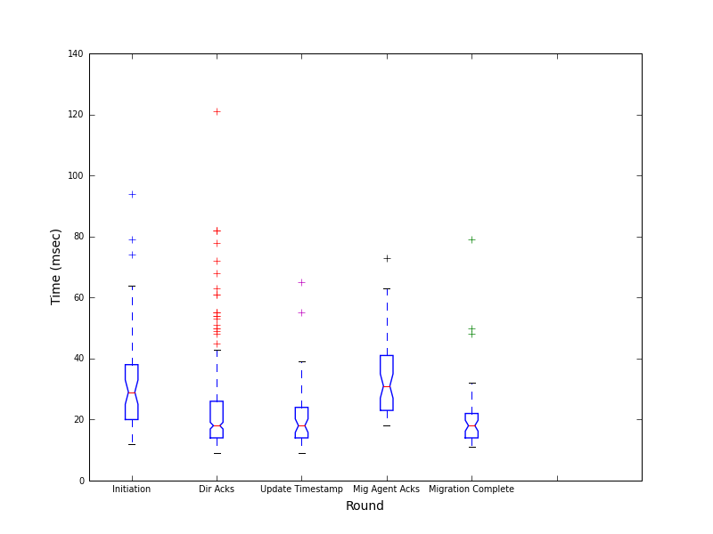
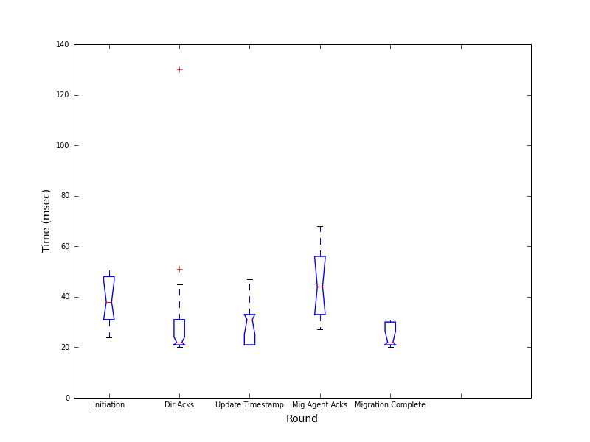
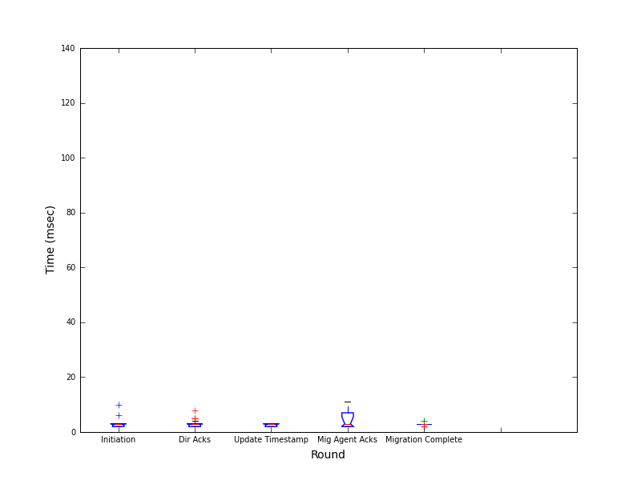
Results: No DummyNet
Database + Protocol
Client end to end
Paxos
Notes:
Server end to end latencies from enqueued to decided should be ~1RTT, so only a few milliseconds. (code + queueing)
Client end to end dominated by service time. (state machine code + DB access)
Non-Uniform, why?
Migration Initiator and Migration Agent processes run on different machines from the leader process, and will hence experience link delays.
The Paxos client for the other rounds is the Protocol process which is running co-hosted with the leader replica, and will only experience inter-process communication delay.

Slide 47
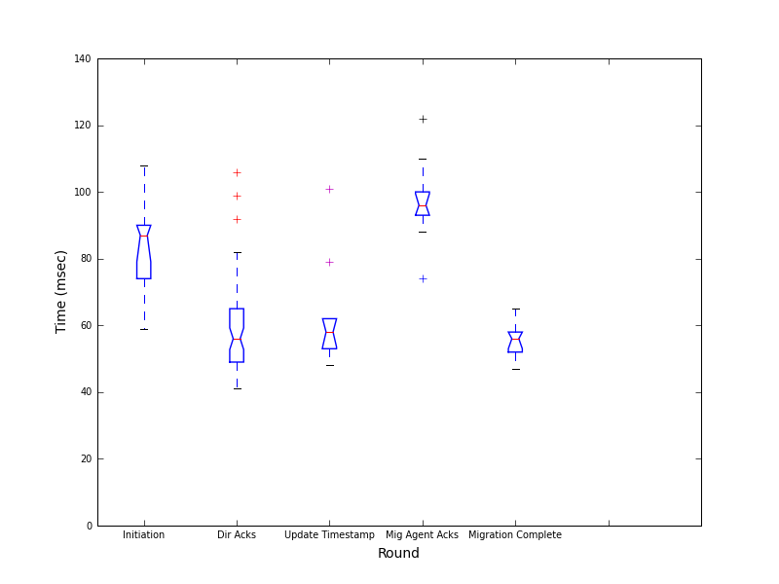
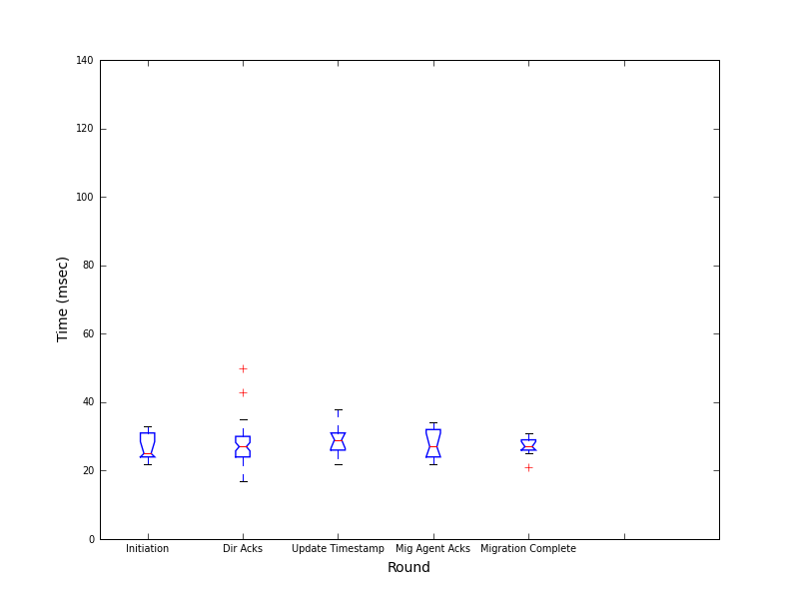
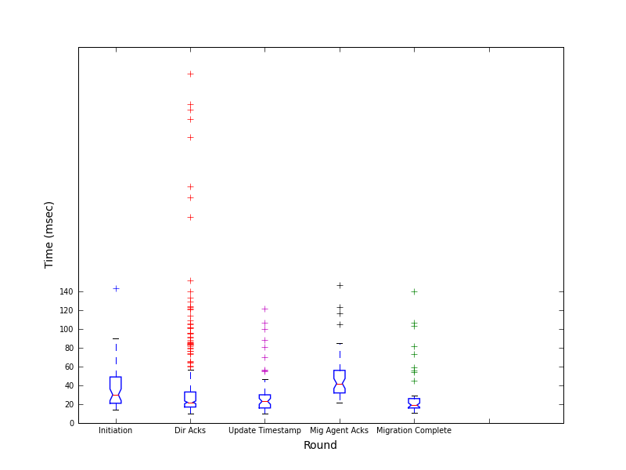
Results: DummyNet with no delay
Client end to end
Database + Protocol
Paxos
Notes:
Expected to be very similar to no DummyNet but large deviation!
Attribute deviation to introduction of DummyNet. Flat 20ms increase across the board for some reason.
Apart from that DummyNet is very imprecise at lower delays – 0ms is emulated as 4-6ms.

Slide 48
Conclusion <--------------------------------- lunch
Overhead of Paxos is clique-based depending on how quickly a majority can be formed.
Dependent on replica positioning.
Growth is (n).
Stateful operations are incur expected overhead. At the very minimum, assume one extra RTT for every UPDATE/INSERT.
Correctness is not strict consistency.
“_ _ _ _ _ _ _ _” Consistency . Pay attention to the fine print!
There is no conflict resolution, since there will never be conflict.
Yes, welcome your perfect world.

Slide 49
BDR: A special word Care.
Customer | Payment | Oustanding | Interest | Day
1 | - | 1000 | 10 | T
1 | 100 | 900 | 10+9 | T+1
1 | 100 | 800 | 10+9+8 | T+2
Customer | Payment | Oustanding | Interest | Day
1 | - | 1000 | 10 | T
1 | 100 | 900 | 10+9 | T+1
1 | 100 | 800 | 10+9+8 | T+2
Interest Daemon
Interest Daemon

Slide 50
BDR: A special word Care.
T+2.9999
Customer | Payment | Oustanding | Interest | Day
1 | - | 1000 | 10 | T
1 | 100 | 900 | 10+9 | T+1
1 | 100 | 800 | 10+9+8 | T+2
Customer | Payment | Oustanding | Interest | Day
1 | - | 1000 | 10 | T
1 | 100 | 900 | 10+9 | T+1
1 | 100 | 800 | 10+9+8 | T+2
1 | - | 800 | 10+9+8+8 | T+3
1 | 100 | 700 | 10+9+8 | T+2.999
Interest Daemon
1 | - | 800 | 10+9+8+8 | T+3
Customer | Payment | Oustanding | Interest | Day
1 | - | 1000 | 10 | T
1 | 100 | 900 | 10+9 | T+1
1 | 100 | 800 | 10+9+8 | T+2
Customer | Payment | Oustanding | Interest | Day
1 | - | 1000 | 10 | T
1 | 100 | 900 | 10+9 | T+1
1 | 100 | 800 | 10+9+8 | T+2
1 | 100 | 700 | 10+9+8 | T+2.999
Interest Daemon
1 | 100 | 700 | 10+9+8 | T+2.999
T+2.9995

Slide 51
But, why?! Timing.
Conflict resolution of last commit wins.
Transaction isolation in distributed environments.
Clock skew.
Complicated application logic.
Bad luck?

Slide 52
Resources this time it’s truly over
github.com/Slania/JPaxos-1
github.com/Slania/dallas_ppt
srangarajan@enova.com
Notes:
What if Brewster is there and makes a sad lolcat face at you for poking fun at him? ☹
Yeah, I dunno then! :’( Can you make him happies?
Like act like a ket and then rub your hed against him and stuff
……Imean…. Icoullldddd but it would be slightly awkward. Slightly.
But you’re a ket. You don’t care about awkward shiz.
But kets adopt people as their pets. They don’t give no shiz about any people other than their own pets. Unless you’re Lee. But Lee’s a dawg, so.
HEY. HE HAS IMPREGNATED A GOOD MANY FELINES K?
So he’s a fabulous ket to other kets with a bad cat personality, but to hoomins he’s a puppy.
SO YOUR POINT IS: not your hoomin, will not kare?
Mhmmmmmmmmmmmmmmmmmmmm.
Am I your hoomin enough for you to kare about me karing about him?
…………does not compute. Pls try again later. ERROR 404.
KHAI
PLIS MAKE HAPPY
NID MANY PLS.
OOPS
GOTO PLIS.
KTHXBAI.
+1 sri
Did you guys perform at the open mic thing later?
The I had me a girl song? Yes, it was recorded & I can bookmark it on your comp later if wanted :)
Cosmos was actually closed earlier this month unfortunately. ☹ lack of funding
Ohnuuuu. Oh, did you upload it to Youtube?
Mr Weaver did yeah ^_^
Great.
We’re planning on covering Dance Me to the End of Love soon. Fantastic! It’s a beautiful beautiful song. Brings back a lot of memories. Mostly threats about you kicking me in the face? Because you were wearing a skirt? And were climbing down from the backyard ledge arch*
Ha. I just realized that I remember “talking” to you about abusive relationships when I first met you in Chicago and then I got myself into one.
???
After the steakhouse we were walking to Stella’s Geckos. We saw homeless people. I commented on how I had plans to help them. You talked about why it’s so hard for some of them because they come from abusive relationships and why it’s hard to get out of them. And I remember thinking that there was too much truth in your voice for that to be a remark/fact/offhand-comment. And then, you abused me for the next 9 months.
Physically? Yeah!
I hope not emotionally, although there was that at the end. Physically though ain’t gonna stop. No, not emotionally.
STILL GOT IT.
I am sincerely considering leaving this as a notes thing for this slide.
I assumed you would. :3
Also, if I’m easily impressed by ( . ) ( . ) then is 8============================================================D bettter?
I mean, it’s not bad to be easily impressed by that, I was just observing. As per usual. Also missed.
= =
= = = =
= =
= . . =
= -- =
Hei ket.
Miaaaaooooouuuu????
Mrrrrwlll
Hei Sriket.
…Hei.
Heihei.
Sriket.
Hei.
Still Life with Woodpecker && Jitterbug Perfume by Tom Robbins

Slide 53
Thank You
Thank You
Thank Me

Slide 54
Directories
Maintain lookup table of mappings between objects and the replica set where they are present
When bootstrapped, they must register through the Directory Client Paxos-ly with contact information
When contacted by Protocol process, synchronously update state and ACK
Idempotent
ID | Host | Port | Timestamp
Serial | IP | Number | Keep-Alive
… | … | … | …
ObjId | Old Set | New Set | Dir ACKs | Mig ACKs | Created At | Completed At | Last Updated At | Mig Started At | Migrated? | Completed?
Obj-1 | 1,2 | 1,3 | Dir1,Dir2 | Agt1 | <time> | <time> | <time> | <time> | F | F
Obj-2 | 1,4 | 2 | Dir1,Dir2 | Agt1,Agt2 | <time> | <time> | <time> | <time> | T | T
… | … | … | … | … | … | … | … | … | … | …

Slide 55
Migration Agents
Blackbox migration process
When bootstrapped, they must register through the Directory Client Paxos-ly with contact information
When contacted by Protocol process, asynchronously perform movement and ACK Paxos-ly
Idempotent
ID | Host | Port | Timestamp
Serial | IP | Number | Keep-Alive
… | … | … | …
ObjId | Old Set | New Set | Dir ACKs | Mig ACKs | Created At | Completed At | Last Updated At | Mig Started At | Migrated? | Completed?
Obj-1 | 1,2 | 1,3 | Dir1,Dir2 | Agt1 | <time> | <time> | <time> | <time> | F | F
Obj-2 | 1,4 | 2 | Dir1,Dir2 | Agt1,Agt2 | <time> | <time> | <time> | <time> | T | T
… | … | … | … | … | … | … | … | … | … | …

Slide 56

Migration Protocol: State Machine tl;dr: every stateful operation is Paxos-ly(ful?)
Protocol
Directory Client
Directory Service
Directory Client
Directory Client
Directory Service
Directory Service
Protocol
Protocol
Migration Agent
Migration Agent
Migration Agent
Mig Init
Dir
Dir
Dir
Notes:
Set dirty/moved bit on an old replica. Reads served from old, write denied.

Slide 57
Logging Timing was, is and always will be a…
Directory Service
(Paxos Replica 1)
Directory Service
(Paxos Replica 2)
Non-invasive: Asynchronous, threaded
Aggregated: Centralized, per-request, per-replica
Detailed and Analyzable: 20+ checkpoints, rich query language
Replica
Received
Propose
Accept
Decide
RequestId
1
0ms
10ms
-
20ms
1
2
-
-
15ms
18ms
1
…
…
…
…
…
…

